Slide 1

Fixing the Stanley Cup Playoffs with Simulation
March 9, 2019
Jackson Taylor

Slide 2




Hi, I’m Jackson!
Work:
School:
Team:
(Until 2021!)

Slide 3
Agenda
01 The Problem
02 Playoff Format Tradeoffs
03 Testing
04 Results
05 Finding Savings / Conclusion

Slide 4

The Problem

Slide 5
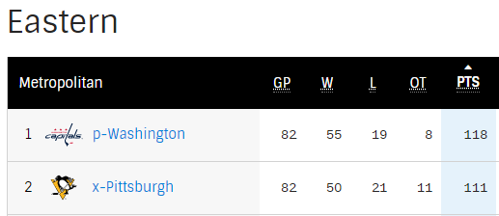
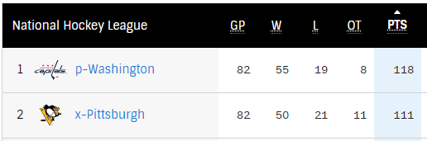
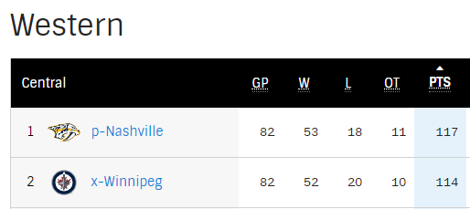
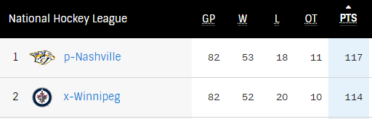
The best teams in the league...
...have been in the same division...
2016-2017 Final Standings
2017-2018 Final Standings

Slide 6

...creating skewed playoff matchups.
Beginning in the 2013-2014 season, the NHL instituted a playoff structure in which the top 3 teams from each division play in the same “corner” of the bracket. The latest any of these teams could meet is in the quarterfinals.
Source: PrintableTeamSchedules.com

Slide 7
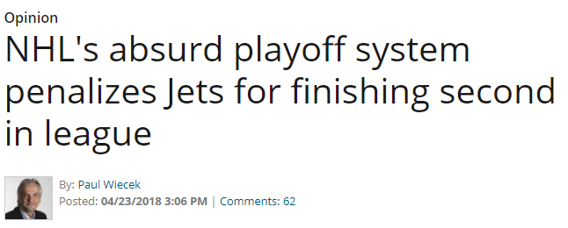
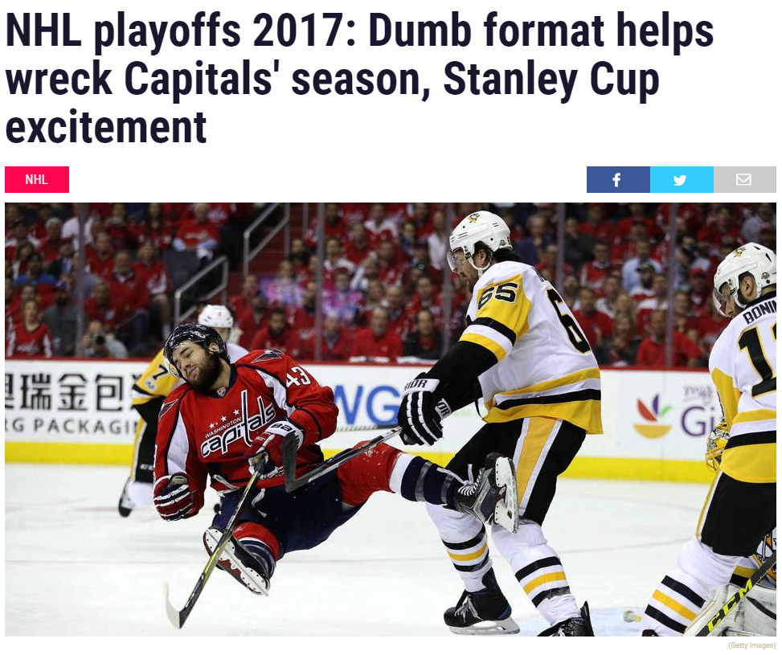
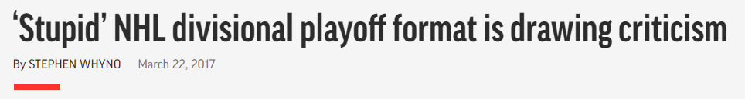

The hockey press is not pleased.
Source: Sporting News, Getty Images

Slide 8

II. The Tradeoffs

Slide 9
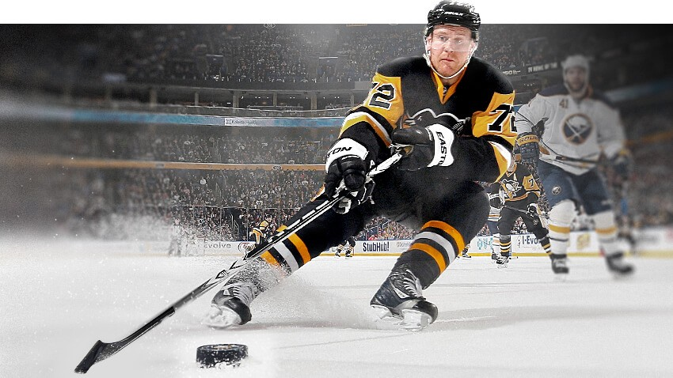
Competitive Balance vs. Travel Distance
Arguments For the Status Quo:
The current playoff system helps to facilitate rivalries.
The current playoff system is more environmentally sustainable because it reduces travel miles. Less travel also means less wear and tear on NHL players.

Slide 10
Competitive Balance vs. Travel Distance
Arguments For the Status Quo:
The current playoff system helps to facilitate rivalries.
The current playoff system is more environmentally sustainable because it reduces travel miles.
We will be testing this argument. Specifically, what impact would alternative playoff formats have on travel distance?

Slide 11
3 Playoff Formats,
2 Testing Conditions
The Status Quo
The top 3 teams in each division are guaranteed a playoff berth, with 2 wild cards. Divisions occupy the same “corner” of the bracket.
Pro: Lowest travel distance.
Con: Least competitively balanced.
Conference Structure with Reseeding
A return to the playoff format used by the NHL until the 2013-2014 season. The winners of each division earned the top 2 seeds in the playoffs, then remaining seeds were determined by total points. The Stanley Cup Final always consisted of a Western Conference and Eastern Conference team.
This option serves as a “middle road” between the other two formats.
Free for All with Reseeding
Teams will be seeded on the basis of final points, without regard to division or conference. The highest winning seed will then play the lowest winning seed in the next round, the second highest seed will play the second lowest seed, etc.
Pro: Most competitively “pure,” opportunities for intriguing Finals matchups.
Con: Likely the most travel.

Slide 12
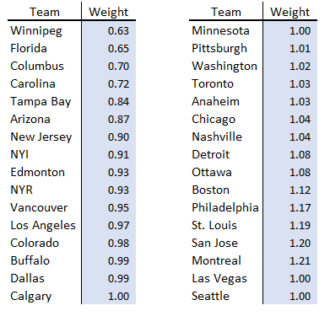
3 Playoff Formats,
2 Testing Conditions
Purely Random
A random number generator determines initial seeding.
Weighted Random
Teams are more or less likely to make the playoffs depending on their historical success.

Slide 13

III. Testing

Slide 14
Assumptions and Notes:
Seattle / Vegas
Seattle is included in the model at a coinflip playoff likelihood, as is Vegas.
Wild Cards
For the status quo model, it is possible for a divisional 5 seed to qualify if they finish with more points than the 4 seed in the other division within the conference. Our model assumes that it is twice as likely for both 4 seeds to qualify for the playoffs than for a 4 and a 5 seed in the same division to qualify.
Tools and Trials
Microsoft Excel was used to build all models. Oracle Crystal Ball was used to simulate all playoff outcomes (n=7500).
Upset Rates
All round win rates follow empirical probabilities (1987-2018). The model assumes each matchup within a playoff round has the same odds of an upset: first round - 37%; quarterfinals - 42%; semifinals - 45%; finals - 35%
Airports
The closest major airport to each team’s arena was used for starting locations. Distance between airports was calculated in a 32x32 matrix using information from the Bureau of Transportation Statistics.
Games in a Series
The total number of games in a series follows empirical probabilities (1987-2018). The model contains a 3x/5x/7x/9x distance multiplier depending on if a series goes 4, 5, 6, or 7 games, accounting for travel from each team.

Slide 15
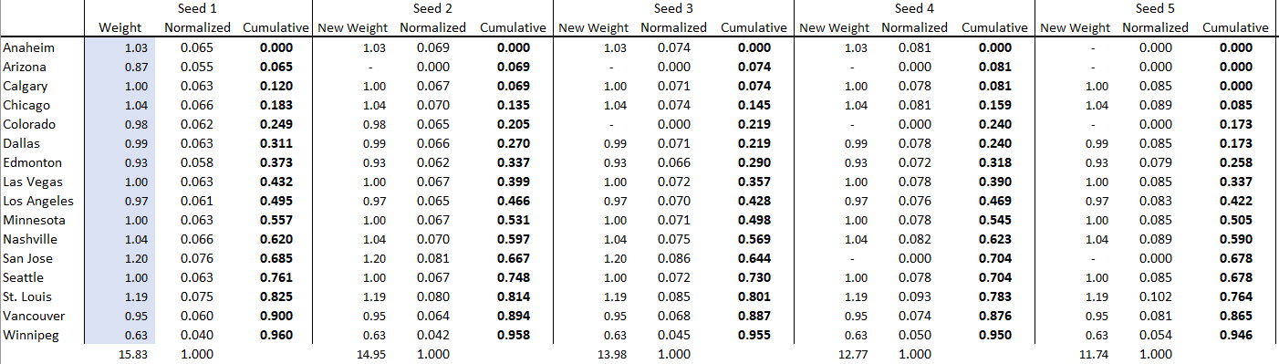
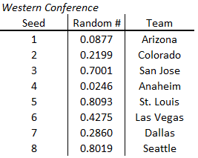
The Stochastic Model:
STEP ONE: Use weighted random numbers to generate a cumulative probability that a team is selected.
STEP TWO: Generate a random number between 0 and 1, pull the team whose cumulative probability is within the range of the random number.
STEP THREE: Remove the team that has already been pulled, re-normalize the data, and pull for the second seed. Repeat this process until all playoff slots are filled.

Slide 16
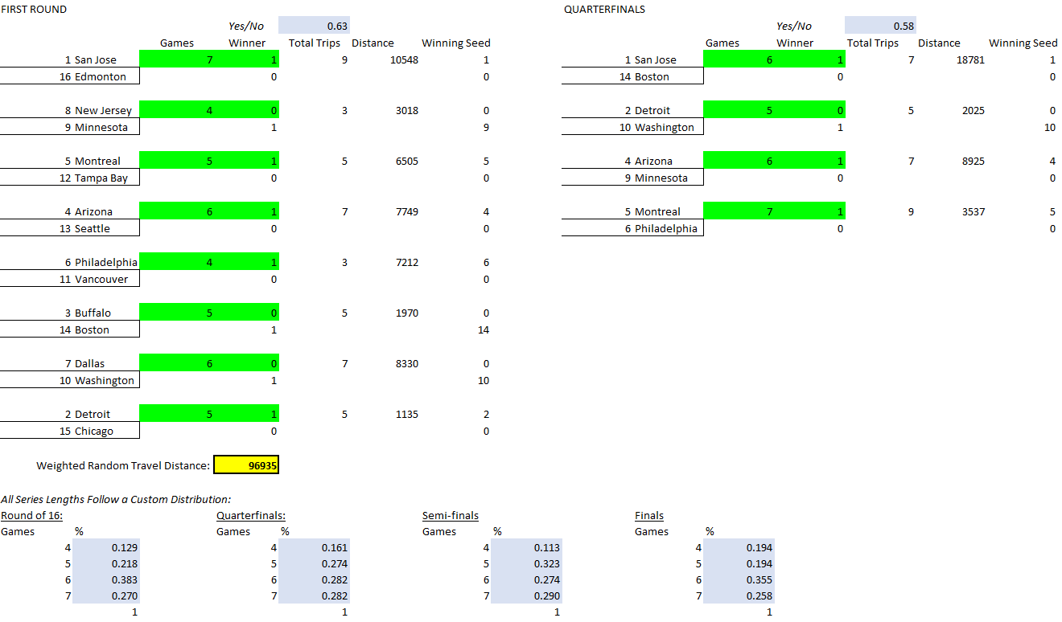
The Stochastic Model:
STEP FOUR: Feed pulled teams into a playoff bracket.
STEP FIVE: Use empirical data to simulate length of series and winners. Multiply total number of trips by distance between teams. Feed winners into next playoff round.
STEP SIX: Add up all distances!

Slide 17

IV. Results

Slide 18
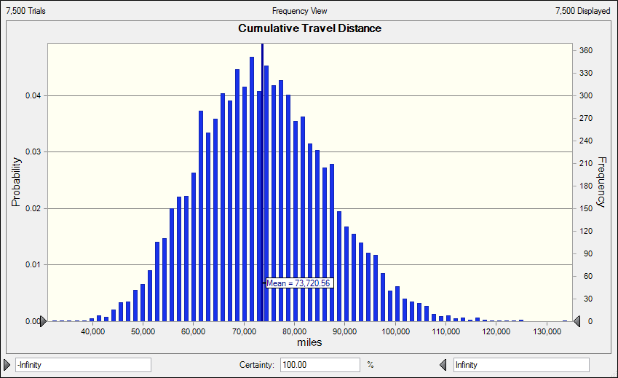
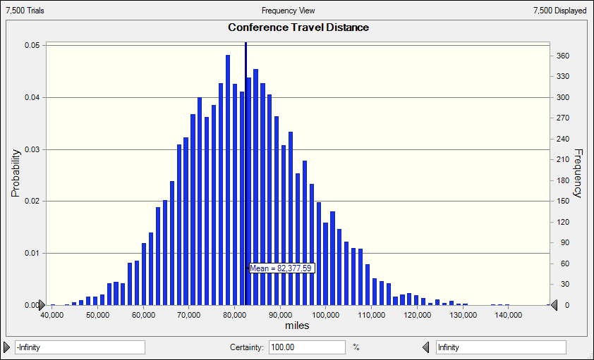
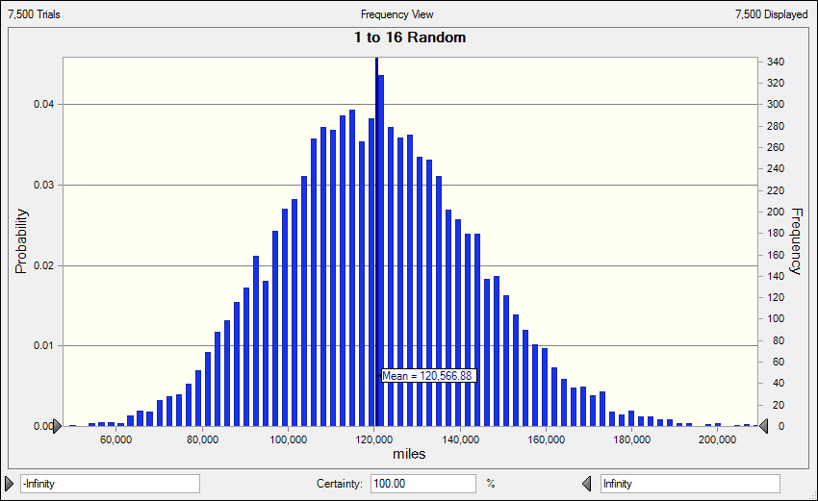
Random Test Condition
Status Quo
Mean: 73,721 miles
Standard Deviation: 12,725 miles
Conference Structure
Mean: 82,378 miles
Standard Deviation: 13,732 miles
Free for All
Mean: 120,567 miles
Standard Deviation: 22,689 miles

Slide 19
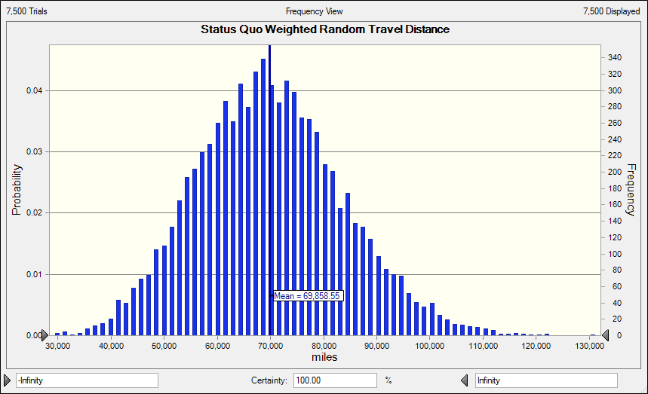
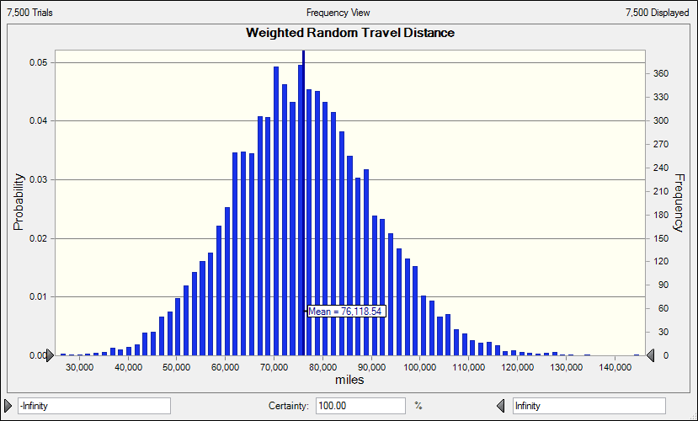
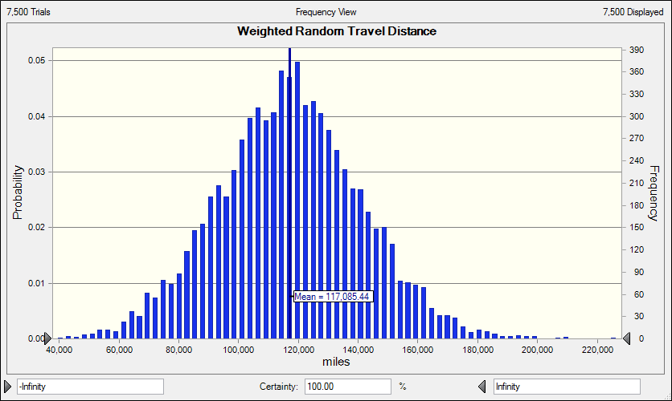
Weighted Random
Status Quo
Mean - 69,859 miles (🔻4.5%)
Standard Deviation - 13,763 miles (▲8.2%)
Conference Structure
Mean - 76,119 miles (🔻7.6%)
Standard Deviation - 14,559 miles (▲6.0%)
Free for All
Mean - 117,085 miles (🔻2.9%)
Standard Deviation - 23,911 miles (▲5.4%)

Slide 20
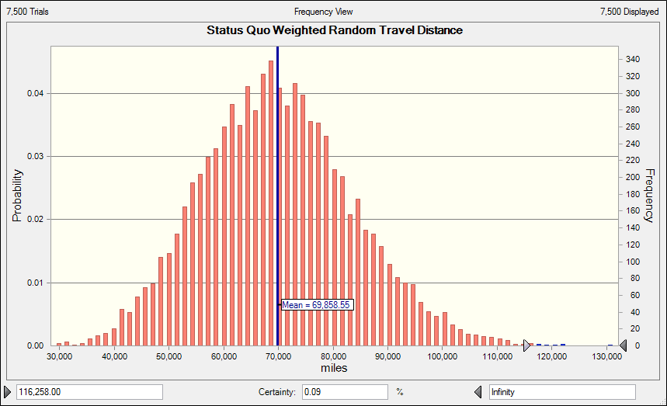
Contextualizing the Data
9%
The percentage of trials in which status quo mileage was more than mean free for all mileage

Slide 21
Contextualizing the Data
47k
1.29m
3.6%
Average increase in mileage between free for all and status quo models
Total NHL regular season travel miles, 2018-2019 season
Difference between FFA playoff travel miles and status quo, expressed as a % of total NHL regular season miles

Slide 22
V. Finding Savings / Conclusions

Slide 23
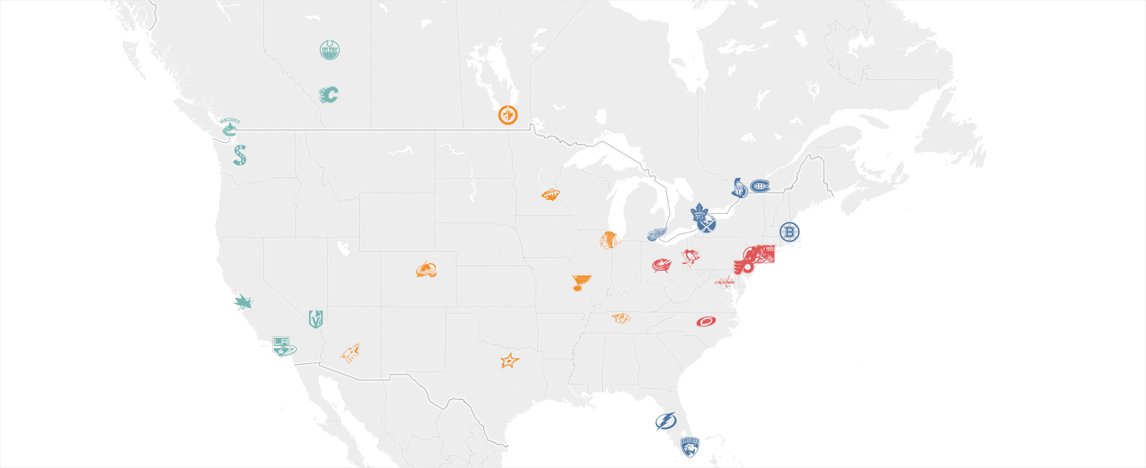
The current divisions are inefficient.
Why?

Slide 24
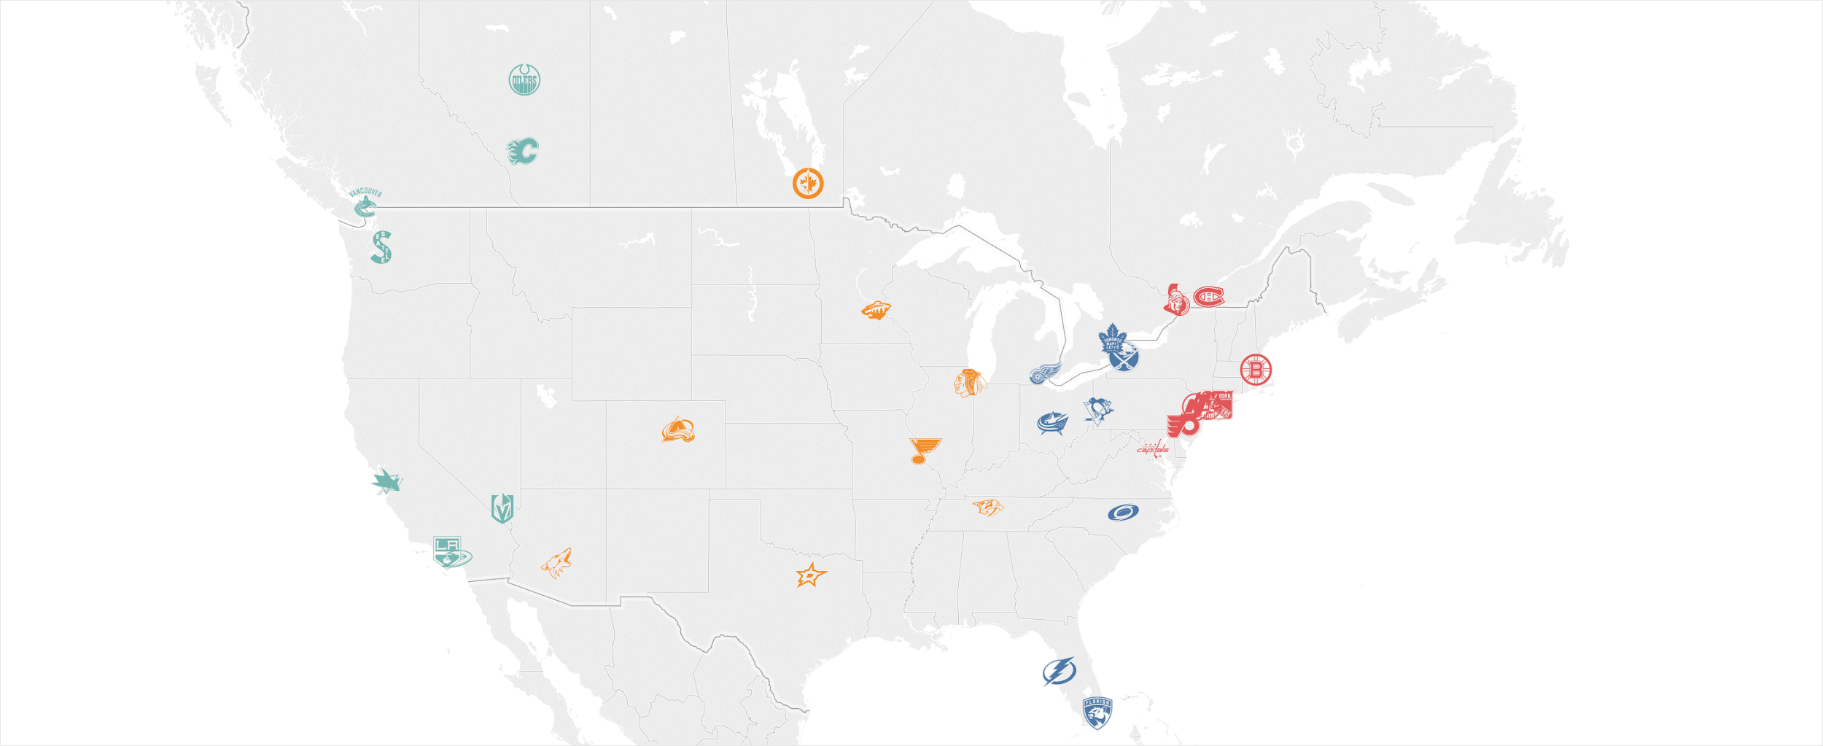
We can claw back miles with efficient divisions.
Moving Carolina, Columbus, and Pittsburgh to the Atlantic Division, and Boston, Montreal, and Ottawa to the Metropolitan Division would produce reduced travel distances for the league.
(Placing Edmonton in the Central and keeping Arizona in the Pacific is 0.3% more efficient, but at a major rivalry cost.)
(Placing Buffalo in the Metropolitan and placing Washington in the Atlantic is 1.3% more efficient, but at a major rivalry cost.)

Slide 25

Conclusions
#1 - The tradeoff between travel distance and competitive balance is real.
The current playoff format results in an average of 39.5% fewer miles traveled for the duration of the playoffs. The current playoff format also exposes the league to less variance in miles traveled.
#2 - Playoff miles traveled are a tiny fraction of total miles traveled.
The difference between playoff formats when expressed as a percentage of the NHL’s regular season miles is very small (3.6%).
#3 - The NHL can help pay for a better playoff by resolving inefficiencies.
The NHL could bank savings from a more efficient division alignment, and spend those savings on a more competitively-balanced playoff.

Slide 26

Thank you!
Twitter - @jacksonbtaylor
Linkedin - jacksonbtaylor
Github - jacksonbtaylor (data files are here!)

Slide 27
APPENDIX

Slide 28
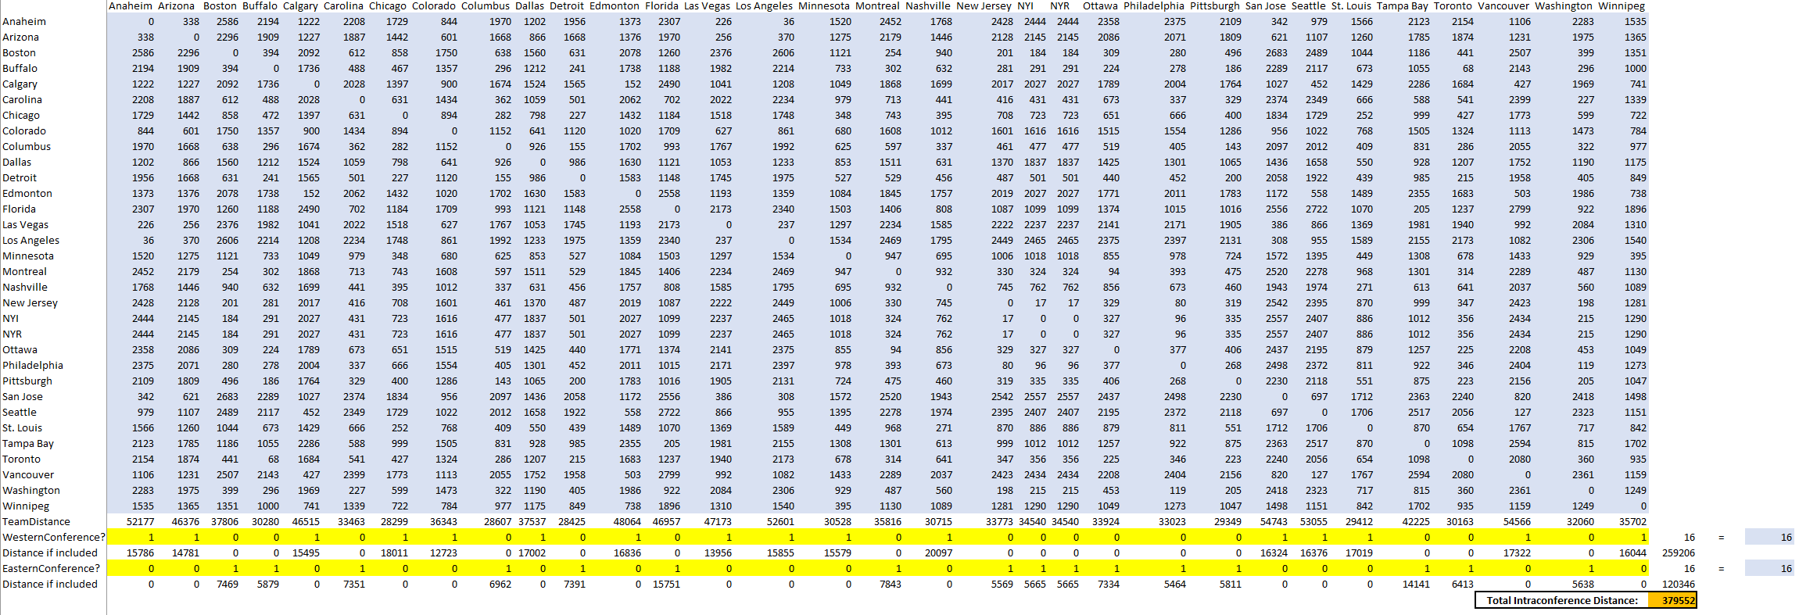
Evolutionary Solver - Conferences

Slide 29
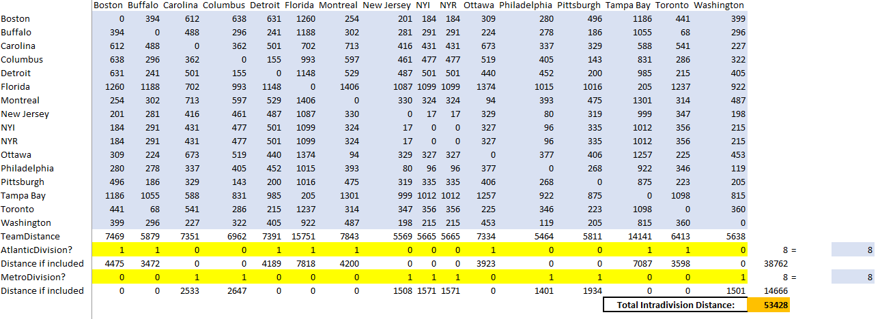
Evolutionary Solver - East Divisions

Slide 30
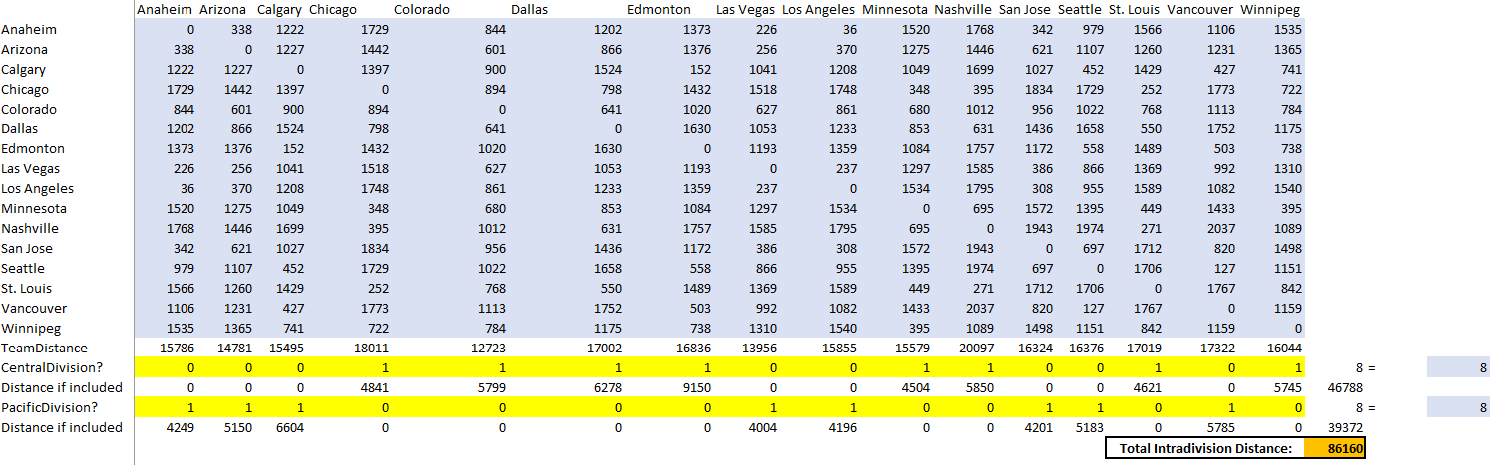
Evolutionary Solver - West Divisions

Slide 31
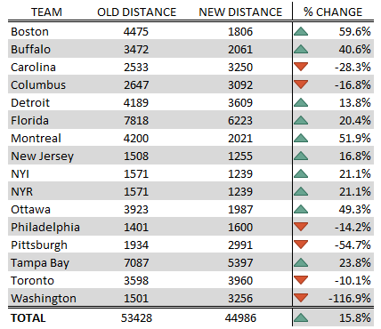
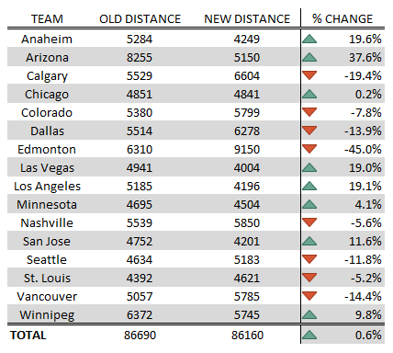
Solver Outcome - Intra-division Distance Data Tables

Slide 32
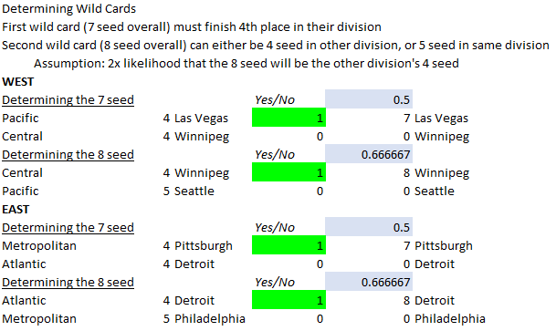
Baking Wild Cards into the model

Slide 33
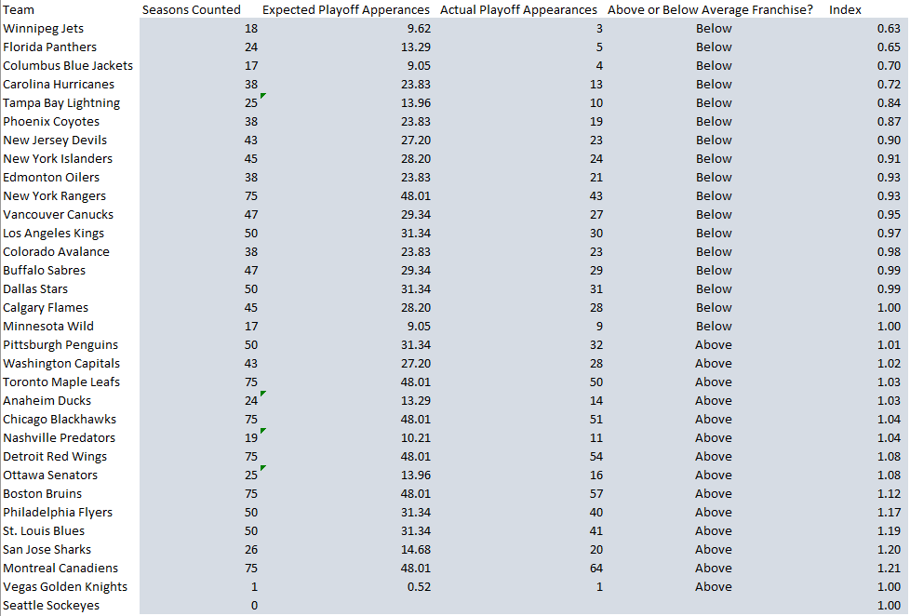
More on making the playoff index

Slide 34
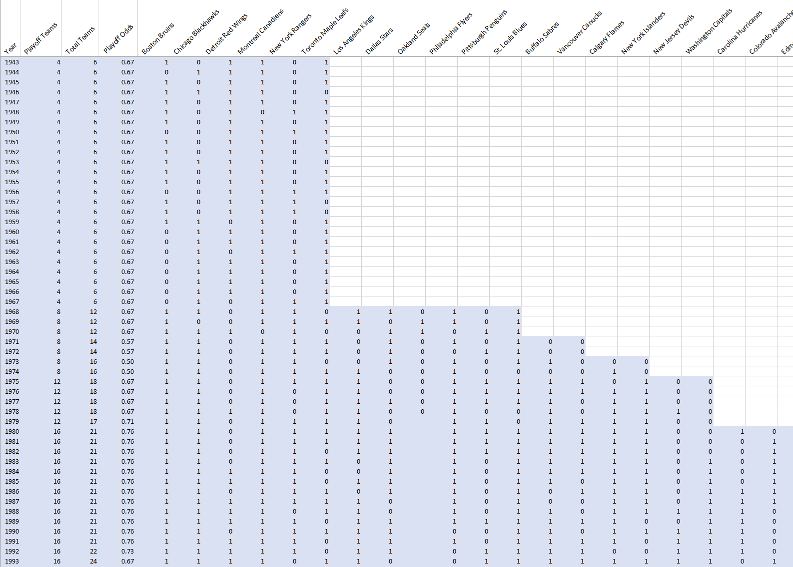
A sampling of the source data for the playoff index

